Slide 1
Skill Assessment
Nathan Smith

Slide 2
Question 1:
Donor Behavior and Geographic Location

Slide 3
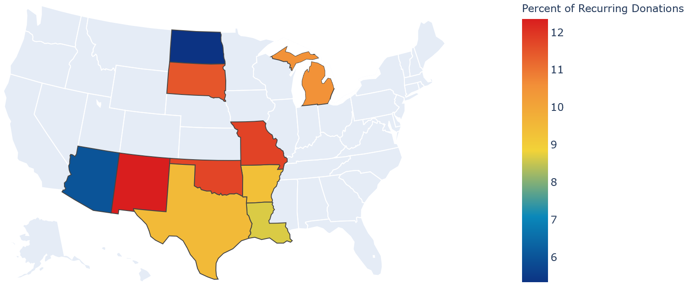
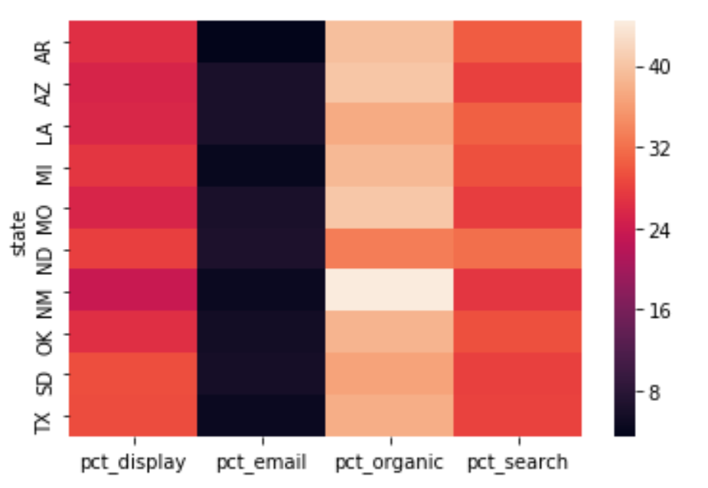
New Mexico responded best to the organic channel of communication, taking up 44% of total donations in that state (see bottom graph displaying the percent of donors by channel and state).
New Mexico also had the highest percent of recurring donations at 12.5%
The percent of donations from the organic channel also had a correlation of +0.7 to average dollars spent on entertainment
Intuitively, organic human relationships can yield more recurring donations. So this insight is very reasonable.
Could this be replicated in Texas which had the highest total Revenue?
Percent of Donations

Slide 4
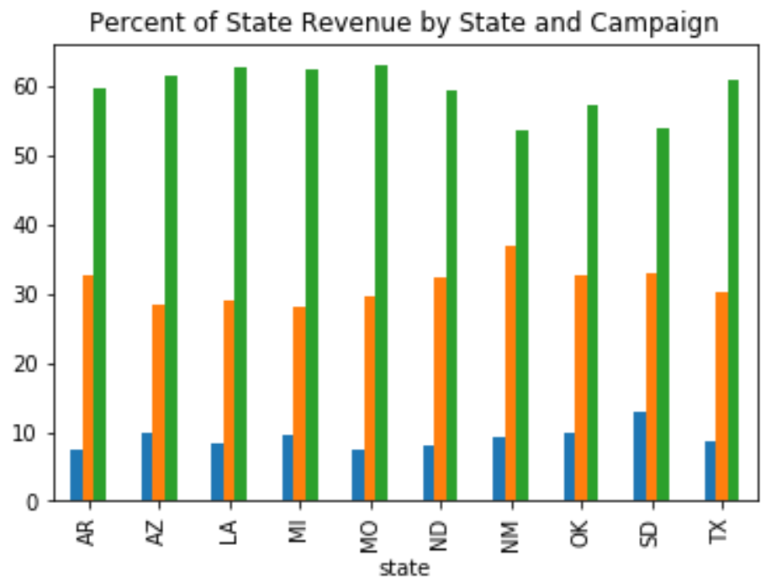
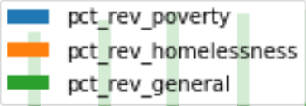
Furthermore, the ‘General’ campaign name seemed to perform the best, producing 60% of the revenue from each state on average.
While this is noteworthy, it is also important to know how much is being invested in each campaign in order to determine their effectiveness.

Slide 5
Conclusion
The most effective channel across all states was the organic channel, with notable performance in New Mexico.
New Mexico also had the highest percentage of recurring
donors, followed by Missouri and Oklahoma.
Oklahoma had higher than average recurring donations and an average percent of revenue. If the focus is on maximizing revenue from recurring donations, expanding to Oklahoma may be a good strategy, specifically using the organic channel and targeting people over the age of 42 to also increase the chances of high one-time donations.
The relative performance (in terms of revenue) of each campaign was relatively the same across all states, with slight exceptions in North and South Dakota.

Slide 6
Question 2:
Campaign Consolidation

Slide 7
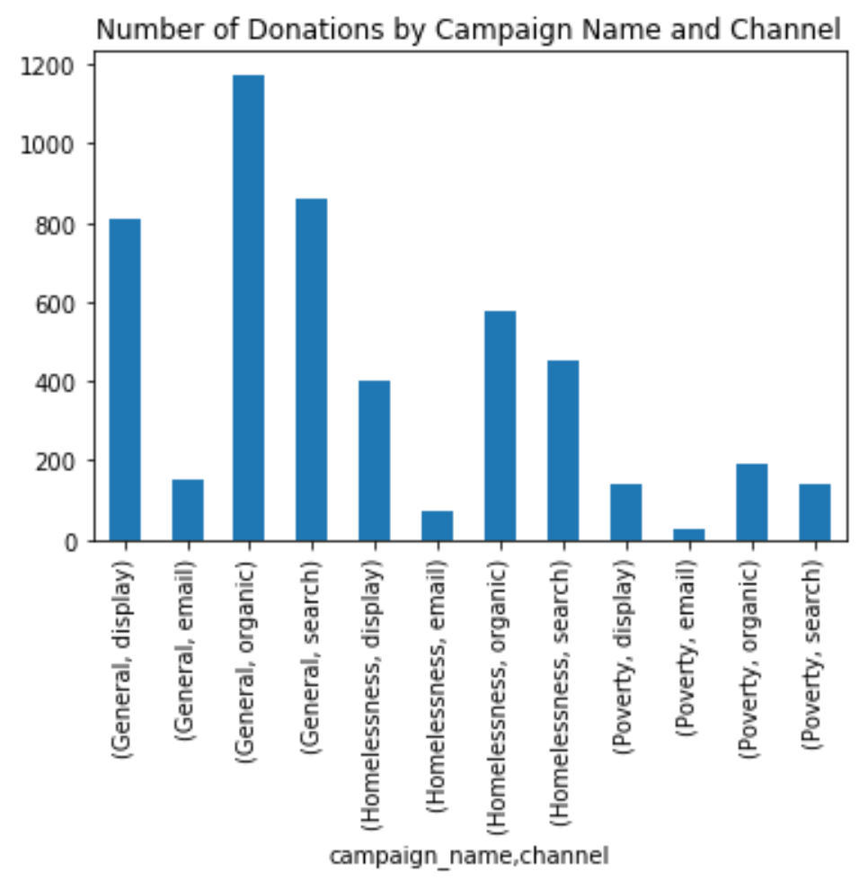
Splitting the data by campaign name and channel, the Poverty campaign has the least number of donations across all channels.
However, it could be the case that the Poverty campaign could perform better than others in at least a few states, while the General and Homelessness Campaigns outperform in the rest.

Slide 8
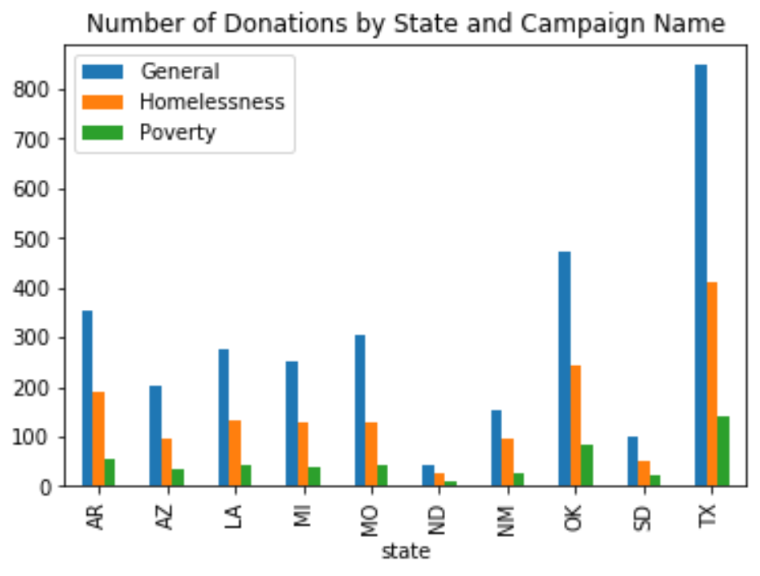
So, If we look at the number of donations by State and Campaign, the Poverty campaign consistently has the least number of donors.
Moreover, the Poverty campaign only accounts for 9% of total revenue across all states. Note that this relationship is the same with slight variance within each state.
Percent of Total Revenue by Campaign
Campaign Name | Percentage of Total Revenue
General | 60.1%
Homelessness | 30.9%
Poverty | 8.9%

Slide 9
Conclusion
They data shows that the Poverty Campaign technically pulls the least revenue and number of donors across all channels and states.
On the surface, this is not a good sign, but analysis cannot be conclusive until we look at the relationships between cost and revenue. If it turns out that the Poverty Campaign actually performs more efficiently than the other two despite its low revenue, it would be wise consolidate the least efficient campaign into Poverty.
However, if about the same amount is being invested into each campaign, then it would be wise to consolidate Poverty into General, since it would be the most efficient.

Slide 10
Question 3:
Discussion of Client Hypotheses

Slide 11
The percentage of recurring donors by campaign name is shown to the right.
Although poverty technically has the highest percentage, it is not statistically significant. If this data were split up by state, the variance in the percentage of recurring donors in each campaign name would easily overcome the Poverty maximum that leads by less than 0.5%
Campaign Name | Percent of Recurring Donors
General | 9.90%
Homelessness | 10.07%
Poverty | 10.40%

Slide 12
When the client says that the Homelessness Campaign ‘brings in the most revenue’, they mean that the average donation in the Homelessness Campaign was the highest. (See Table 1)
If we look at the percentage of total revenue for each campaign (Table 2), the General Campaign brings in 60% of all revenue .
If the we assume that the company is allocating a similar amount of resources to each campaign, then the General campaign is clearly performing the best as opposed to the Homelessness Campaign
Table 1: Average Donation by Campaign
Campaign Name | Donation Revenue
General | $84.06
Homelessness | $87.04
Poverty | $75.31
Table 2: Percent of Total Revenue by Campaign
Campaign Name | Percentage of Total Revenue
General | 60.1%
Homelessness | 30.9%
Poverty | 8.9%

